Slide 1

COVID AND THE NBA
HAMZAH SALEH, AMRIT SINGH, LIFU TAO, TSZCHUNG CHEUNG, SHAZID RAHMAN, IBRAHIM HASSANAIN
CSC 59969
VISUALIZATION
Prof. Ronak Etemadpour

Slide 2
TABLE OF CONTENTS
page3
page9-10
page4
page11
page5-7
page12
page13
page8
page14
INTRODUCTION
METHODS
DATA SPECIFICATIONS
OBSERVATIONS
BACKGROUND/RELATED WORK
CONTRIBUTION
LIMITATION
DATA SETS
CONCLUSION

Slide 3
INTRODUCTION
The National Basketball Association has the best basketball players in the world competing at the highest level on the biggest stage.
Numerous NBA players contracted COVID-19, had to recover, and get back into playing shape.
Playing in an empty gym with no fans was a drastically different environment than players were used to.
In our final project, we use visualization techniques to see if COVID-19 has impacted the NBA and its players in any way.
Specific topics that we focused on was player and team performance and efficiency, as our research questions revolved around that

Slide 4
DATA SPECIFICATIONS
Most of the data we used was from online sources
NBA API as well as ESPN API
Our data was very analytical and numerical.
We were mainly concerned of player and team performances and efficiencies.
This data was significant to help us answer our proposed question: How did COVID impact the NBA?
COVID impacted NBA performances - evident in numbers through our data sets

Slide 5
BACKGROUND AND RELATED WORK
We conducted research on the NBA to see the various factors affecting the game
COVID played a key role in affecting today's game
However other factors such as the games evolution itself, changed the way the game is perceived today
Also, we looked at other articles to help propose some questions our visualizations would then answer:
For example: Did players perform better during the Covid-19 season? Or did the lack of an audience cause players to underperform?

Slide 6
BACKGROUND AND RELATED WORK
Link: https://www.nature.com/articles/s41598-020-78901-2 - Covid Impact
The first article we looked at discussed the impacts that Covid-19 has had on the NBA.
The article specifically discusses the change in winning percentages for teams in the Western and Eastern Conference.
With Covid-19, travelling games for teams feel different, there is no audience cheering or booing the team, meaning there is no mental factor on how a game will turn out. The data is checking to compare the overall win percentage for teams in each conference, whether they are playing home court, or away. This data can further be used to compare if there is any change in the win percentages when comparing them to seasons before Covid-19.

Slide 7
BACKGROUND AND RELATED WORK
Link: https://www.wsj.com/articles/nba-3-point-revolution-11611190418 - Change in Shots
https://www.cbssports.com/nba/news/how-stephen-curry-ushered-nbas-greatest-shooting-era-and-changed-the-perception-of-championship-teams/ - Impact of Stephen Curry
The second article we looked at discussed the change in the actual game of basketball, and how over the past few seasons the offensive play style of players is starting to shift.
Majority of shots that are attempted on the court are either mid-rangers, or three-point shots.
The article seems to emphasize the shift to more three-point shots being taken.
One visualization that can be created would be a PCA that can showcase the different groups of offensive players in the current NBA, and what their mean shot averages look like.

Slide 8
DATA SETS
https://raw.githubusercontent.com/asingh2066/Visualization/main/NBA-stats-covid.csv
https://raw.githubusercontent.com/asingh2066/Visualization/main/NBA-stats.csv
https://raw.githubusercontent.com/asingh2066/Visualization/main/Players.csv
https://raw.githubusercontent.com/asingh2066/Visualization/main/injuries_2010-2020.csv
https://raw.githubusercontent.com/asingh2066/Visualization/main/nba_shot_types.csv
https://docs.google.com/spreadsheets/d/e/2PACX-1vTTkcPCsa9DtbFsyJUu7DRHC9xEVvap73sX-DTLh-uynXNB0d3K6oGT7teWULscTzljZkoq51ClrWXs/pub?output=csv

Slide 9
METHODS
Our team decided on using multiple methods in creating our visualizations.
One of the main methods we used was Python Notebook through Google Collaborate.
We found this method very useful because we were able to create numerous visualizations to represent our data using one language.
However, we also decided to use vegalite to represent another data set (Team Performances)
Visualizations types:
Choropleth Maps
PCA methods
PIe charts
Horizontal/vertical bar graphs
Scatter plots

Slide 10
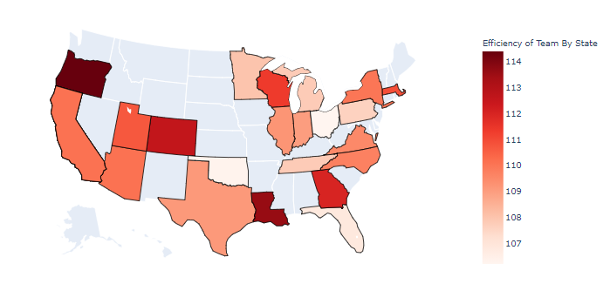
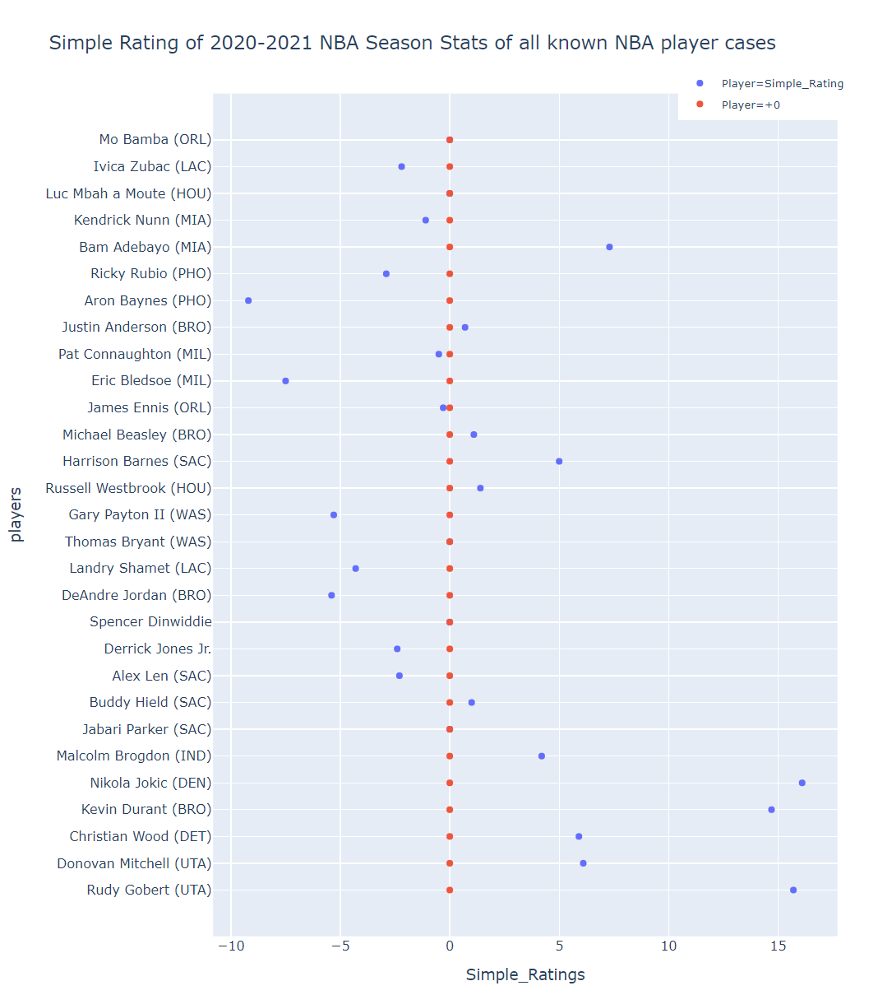
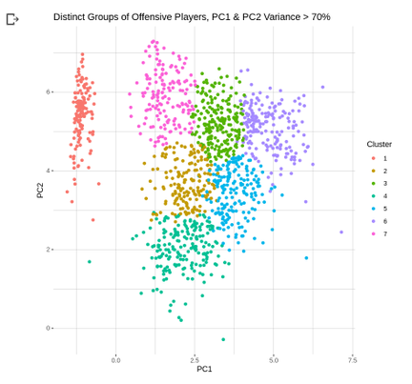
Choropleth on team efficiency before and during the covid season
PCA on players categorized in different groups based on performance
Performance of all NBA players who have had Covid-19

Slide 11
OBSERVATIONS
After numerous visualizations created, we started to observe various trends relating to the NBA
One of the patterns we noticed was that COVID-19 did not have a huge impact on the game as we thought it would.
Relatively speaking, most big name teams remained top 3 in contending for the NBA championship.
However, an important observation seen from our methods, was that the low-tier teams were significantly on the rise in their team and player performances.
Teams that usually are ranked on the bottom of the NBA table, e.g. Utah Jazz, started to drastically have better performances and efficiencies.
In conclusion though, only a few low-ranked teams were able to perform at higher levels through the pandemic. Most high-ranked teams and players stayed in their respective positions.

Slide 12
CONTRIBUTIONS
How did we contribute with our research?
Our visualizations and research mainly focused on player and team performance during and before covid, however we drew conclusions on how other factors such as lack of fan attendance and numerous injuries may have caused changes in the efficiency of these players and teams.
We also realized that when it came to performance, the NBA players and teams were affected.
However, some other research we found that was not relating to player/team performances was that the NBA took a drastic hit when it came to revenue just like most businesses in the world.
As a result, the NBA implemented a new Play-In tournament that would accommodate for the lower ranked teams meaning more games played.
In essence, they increased their ratings and revenue by giving struggling teams a chance to have a play-in tournament to reach the playoffs.

Slide 13
LIMITATIONS
Creating visualizations was mainly a new technique for most of us to represent data sets.
We were struggling at first to create and form of visualizations
However with the help of the professor and as the semester went on, we were able to get a slight hang of it.
With that being said, we tried our best to follow Edward Tufte’s principles in implementing our methods and visualizations.
Finally, COVID wasn't the best of factors for our topic since there was many other factors that usually affect the NBA players/teams such as trades, salary caps, draft picks, and many other factors that could have had a more crucial role on our visualizations.
‹#›

Slide 14
CONCLUSION
The main takeaway from our report and visualizations is that many teams and players have stayed consistent throughout the pandemic.
However, some underperforming teams for regular seasons were able to turn it around and perform at a high efficiency.
Players before COVID were very similar in performances during the COVID season this year
Other factors like injuries and fan attendance played a minute role in affecting performances of players and teams.
Collectively, the main answer we got from our proposed question was that teams/players performed at a regular efficiency while losing teams started playing at higher levels.

